Slide 1
Preliminary Design Review (PDR)
Charger Rocket Works
University of Alabama in Huntsville
NASA Student Launch 2013-14
Kenneth LeBlanc (Project Lead)
Brian Roy (Safety Officer)
Chris Spalding (Design Lead)
Chad O’Brien (Analysis Lead)
Wesley Cobb (Payload Lead)

Slide 2
Prometheus Flight Overview
Event | Value | Units
Max Speed | 1960 | ft/s
Time To Apogee | 24.9 | s
Apogee | 14800 | ft
Time at Main Deploy | 176 | s
Main Chute Deployment Altitude | 1000 | ft
Ground Impact Speed | 7.0 | ft/s
Nose Cone Impact Energy | 0.83 | ft-lbf
Body Impact Energy | 15.9 | ft-lbf

Slide 3
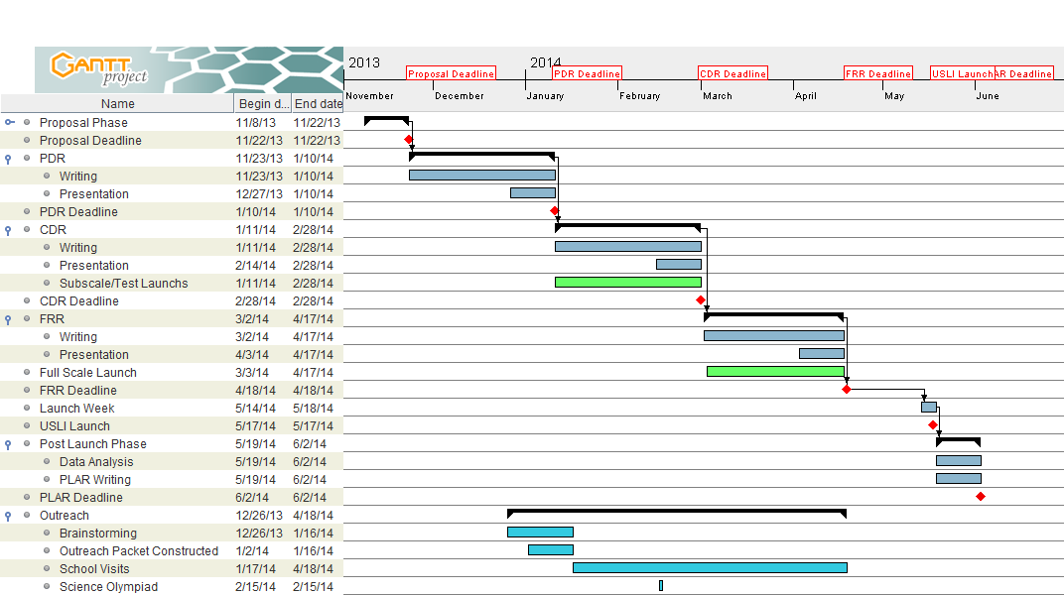
Project Schedule

Slide 4
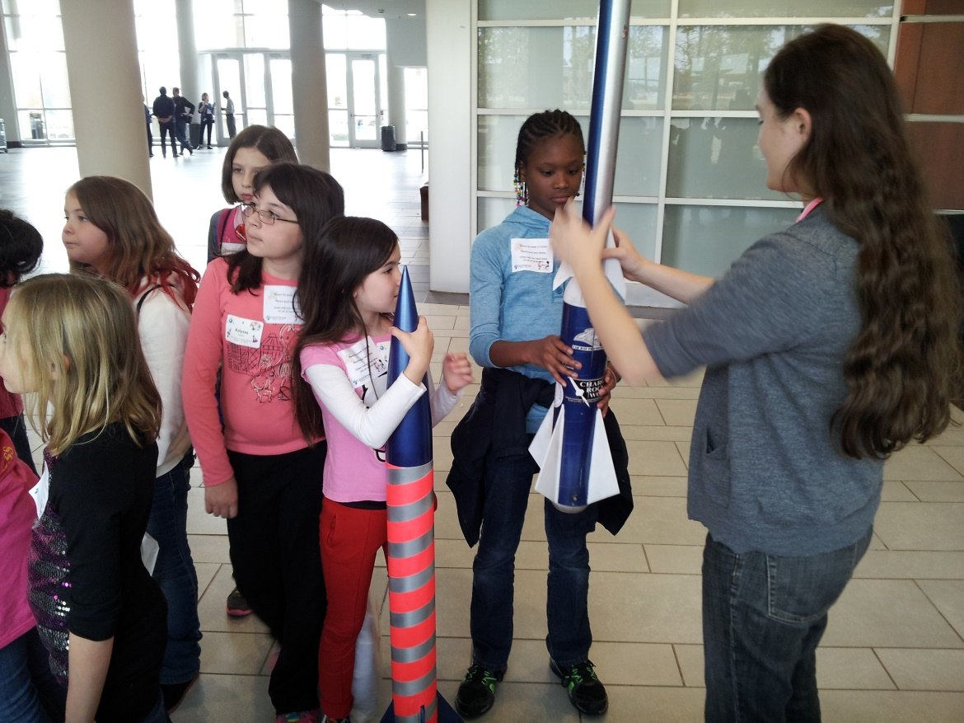
Outreach
Under Construction
Modular in Nature
Adaptable for different ages and lengths
Supporting activity
Water Rockets
Drag Experiment
Packet format for easy integration into existing events

Slide 5
Materials and Justifications
Component | Material | Justification
Body Tube | Carbon Fiber | High strength requirement, ease of fabrication, student learning experience
Fins | Carbon Fiber | High strength requirement, ease of fabrication, student learning experience
Bulkheads | Carbon Fiber | High strength requirement, ease of fabrication, student learning experience
Nose Cone | Fiberglass | Radio transparency, moderate strength requirement
Payload Bays | 3D Printed ABS | Low strength requiement, low weight, complex profiles possible
Payload Shaft | Alumium | Low weight, threaded shaft required

Slide 6
Vehicle Component Discussion
Body Tube
4.5” inside diameter
Wrapped carbon fiber tube
Carbon cloth wrapped over mandrel
High strength, ease of fabrication

Slide 7
Vehicle Component Discussion
Payload Shaft
3/8” Aluminum Thread
Threaded into motor case end cap
Passes thrust/ recovery forces into bulkhead, payloads, etc
Retains body tube segments

Slide 8
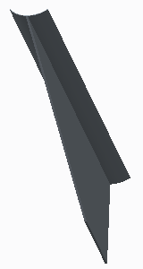
Vehicle Component Discussion
Fins
Carbon fiber
Nanolaunch profile
Two piece design allowing large flange fabrication

Slide 9
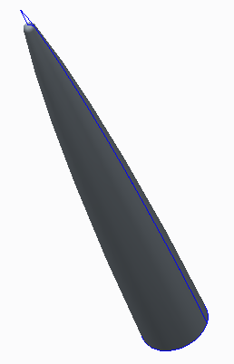
Vehicle Component Discussion
Nose Cone
Fiberglass
Nanolaunch Profile
Will include Nanolaunch payload components

Slide 10
Next Steps
Hardware
Materials and Structures Testing
Design Refinement
Subscale and Prototype Fabrication

Slide 11
Launch Vehicle Verification
Tension tests of materials samples
Control samples and samples heated to temperatures shown in supersonic CFD analysis
Confirms suitability of standard epoxy for short bursts at supersonic temperatures
Compression tests to failure of representative high stress components
Confirms design calculations
Proof loading of actual flight hardware
Non destructive
Confirms strength of critical, difficult-to-inspect epoxy joints

Slide 12
Static Stability Margin
OpenRocket simulated CG and CP
Vehicle is stable
$H_{0}≅\frac{X_{cp}−X_{cg}}{D};H_{0}>1$
Supersonic flight
X_{cp} expected to grow
X_{cg} expected to shrink
Stability expected to increase

Slide 13
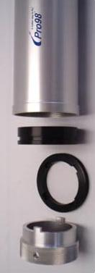
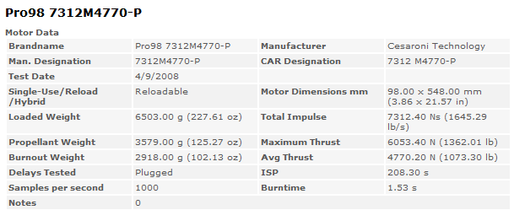
Baseline Motor Selection
Cessaroni Technology Incorporated - 7312 M4770-P
3 Grain
High Impulse (7,312 N-s)
Low Burn Time (1.53 seconds)
Thrust to Weight Ratio (36.5)

Slide 14
Projected Flight Path
Event | Value | Units
Total Flight Time | 249 | sec

Slide 15
Ascent
Event | Value | Units
Time To Apogee | 24.9 | seconds
Apogee | 14800 | ft

Slide 16
Powered Flight
Event | Value | Units
Burn Time | 1.53 | seconds
Burn Out Altitude | 1500 | feet
Burn Out Velocity | 1900 | fps
Max Acceleration | 43 | G’s

Slide 17
Descent
Event | Value | Units
Drogue Release | 26 | seconds
High Altitude Descent Speed | 100 | ft/s
Main Release | 1000 | ft
Low Altitude Descent Speed | 7 | ft/s
Impact Energy Bottom Section | 15.9 | lbf
Impact Energy Nose Cone | 0.83 | lbf

Slide 18
Mass Variance Analysis
Monte Carlo Method
$μ=29.337lb$
$σ=1.467lb \left(5\%\right)$
150 Test Cases

Slide 19
Next Steps
Analysis
CFD-ACE+ Fluid Dynamics Models
Post Flight Analysis
Generate a 6-axis Flight Trajectory Model using Commercial Software

Slide 20
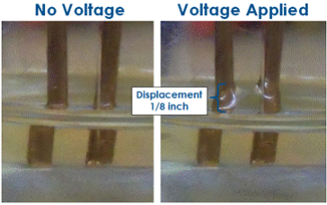
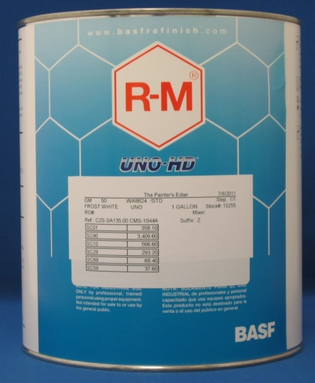
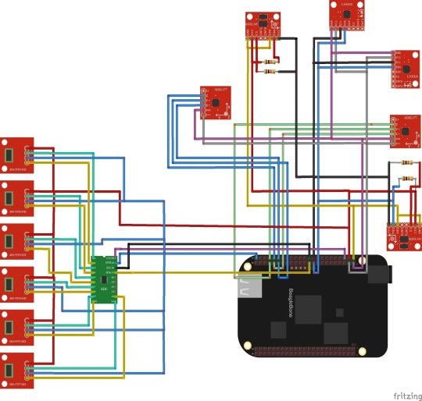
Payload Systems
Dielectrophoresis
Effects of Supersonic Flight on Paints/Coatings
Nanolauch 1200 Experiment
Landing Hazard Detection System

Slide 21
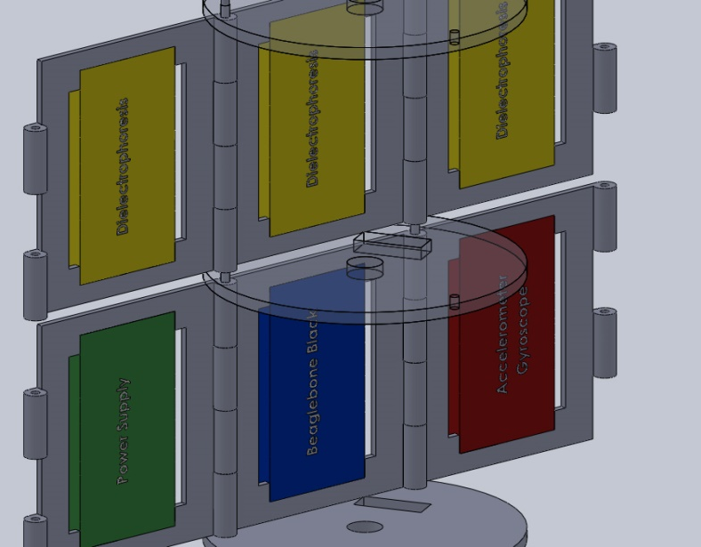
Baseline Payload Design
Segmented modular design
Customizable
Able to be arranged for CG
Can be inserted and removed in one piece
Consolidated
Easy Maintenance
Designed to account for high G-forces

Slide 22
Payload Verification and Test Plan
Payload Requirement | Design Capability | Risk | Metric/Verification
Administer High Voltage Dielectric Test | Provide same voltage as previous experiments | Electric shock or dielectric failure | Post flight video inspection and buzzer sounding to indicate voltage is on.
Microgravity | Experience a second of low g to run experiment | Not enough time to see clear results | Post-flight video inspection
Coatings and Paint | Two different coatings/ paints for analysis | Rocket appearance could change depending on the paint’s reaction to the heat. | Visual inspection of surface roughness changes, most heat resistant, and durability of coating
Preflight Post flight surface analysis | Optical microscope analysis of the surface before and after flight | Deterioration of initial paint/coating due to high heat | Pre-flight vs Post-flight inspection/analysis comparison at microscopic level

Slide 23
Payload Verification and Test Plan
Payload Requirement | Design Capability | Risk | Metric/Verification
Hazard detection camera | Hang a camera below the rocket on descent | Camera tangles up with the shock cord or parachute, and/or blocks the camera view | Camera deploys safely and analyzes the landing zone
Live Data Feed | Recording data if the ground below is clear of hazards | Camera results could be inconclusive due to swaying motion of parachute | Ground station receives live conclusive evidence of landing hazards
Recoverable and Reusable | Capable of being launched again on the same day without repairs or modifications | All or some of the systems/subsystems destroyed due to recovery failure | All payload components recovered, and in working condition

Slide 24
Next Steps
Avionics and Payload
Payload Sled Fabrication and Strength Test
Component Calibration and Testing
LHDS Development
Nanolaunch Program Code

Slide 25
Question
&
Answer

